Slide 1

Propositional Logic

Slide 2
Statement (Proposition)
A Statement is a sentence that is either True or False
Examples:
2 + 2 = 4
True
3 x 3 = 8
False
787009911 is a prime
Non-examples:
x+y>0
x²+y²=z²
They are true for some values of x and y
but are false for some other values of x and y.

Slide 3


Logic Operators
~p is true if p is false
P
Q
P Q
P
Q
P Q
T
T
T
T
T
T
T
F
F
T
F
T
F
T
F
F
T
T
F
F
F
F
F
F

Slide 4



Compound Statement
p = “it is hot”
q = “it is sunny”
It is hot and sunny
It is not hot but sunny
It is neither hot nor sunny

Slide 5

Exclusive-Or
coffee “or” tea
⊕
exclusive-or
How to construct a compound statement for exclusive-or?
Idea 1: Look at the true rows
Idea 1: Look at the true rows
Idea 1: Look at the true rows
p | q | p ⊕ q
T | T | F
T | F | T
F | T | T
F | F | F
Want the formula to be true
exactly when the input belongs
to a “true” row.
The input is the second row exactly if this sub-formula is satisfied
And the formula is true exactly when the input is the second row or the third row.

Slide 6
Exclusive-Or
coffee “or” tea
⊕
exclusive-or
How to construct a compound statement for exclusive-or?
p | q | p ⊕ q
T | T | F
T | F | T
F | T | T
F | F | F
Idea 2: Look at the false rows
Want the formula to be true
exactly when the input does
not belong to a “false” row.
The input is the first row exactly if this sub-formula is satisfied
And the formula is true exactly when the input is not in the 1st row and the 4th row.

Slide 7



Logical Equivalence
Idea 3: Guess and check
p | q
T | T | F | T | F | F
T | F | T | T | T | T
F | T | T | T | T | T
F | F | F | F | T | F

Slide 8
Logical Equivalence
Idea 3: Guess and check
p | q
T | T | F | T | F | F
T | F | T | T | T | T
F | T | T | T | T | T
F | F | F | F | T | F
Logical equivalence: Two statements have the same truth table
As you see, there are many different ways to write the same logical formula.
One can always use a truth table to check whether two statements are equivalent.

Slide 9
Logical Equivalence
Idea 3: Guess and check
p | q
T | T | F | T | F | F
T | F | T | T | T | T
F | T | T | T | T | T
F | F | F | F | T | F
Logical equivalence: Two statements have the same truth table
As you see, there are many different ways to write the same logical formula.
One can always use a truth table to check whether two statements are equivalent.

Slide 10
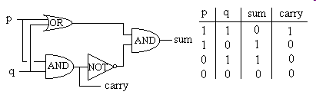
Writing Logical Formula for a Truth Table
Digital logic:
Given a digital circuit, we can construct the truth table.
Now, suppose we are given only the truth table (i.e. the specification),
how can we construct a circuit (i.e. formula) that has the same function?

Slide 11













Writing Logical Formula for a Truth Table
Use idea 1 or idea 2.
Idea 1: Look at the true rows
and take the “or”.
p | q | r | output
T | T | T | F
T | T | F | T
T | F | T | T
T | F | F | F
F | T | T | T
F | T | F | T
F | F | T | T
F | F | F | F
The formula is true exactly when the input is one of the true rows.

Slide 12



Writing Logical Formula for a Truth Table
Idea 2: Look at the false rows,
negate and take the “and”.
p | q | r | output
T | T | T | F
T | T | F | T
T | F | T | T
T | F | F | F
F | T | T | T
F | T | F | T
F | F | T | T
F | F | F | F
The formula is true exactly when the input is not one of the false row.

Slide 13
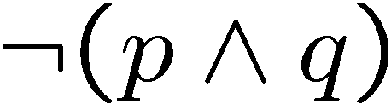
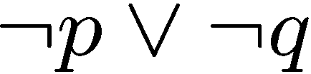


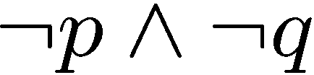
DeMorgan’s Laws
Logical equivalence: Two statements have the same truth table
De Morgan’s Law
Statement: Tom is in the football team and the basketball team.
Negation: Tom is not in the football team or not in the basketball team.
De Morgan’s Law
Statement: The number 783477841 is divisible by 7 or 11.
Negation: The number 783477841 is not divisible by 7 and not divisible by 11.

Slide 14



DeMorgan’s Laws
Logical equivalence: Two statements have the same truth table
De Morgan’s Law
T | T | F | F
T | F | T | T
F | T | T | T
F | F | T | T
De Morgan’s Law

Slide 15
Laws of Boolean algebra
Commutative Law states that the interchanging of the order of operands in a Boolean equation does not change its result.
For example:
OR operator → A + B = B + A
AND operator → A * B = B * A
Associative Law of multiplication states that the AND operation are done on two or more than two variables.
For example: A * (B * C) = (A * B) * C
Distributive Law states that the multiplication of two variables and adding the result with a variable will result in the same value as multiplication of addition of the variable with individual variables.
For example: A + BC = (A + B) (A + C).

Slide 16
Laws of Boolean algebra
Annulment law: A.0 = 0 A + 1 = 1 | Complement law: A + A' = 1 A.A'= 0
Identity law: A.1 = A A + 0 = A | Double negation law: ((A)')' = A
Idempotent law: A + A = A A.A = A | Absorption law: A.(A+B) = A A + AB = A

Slide 17
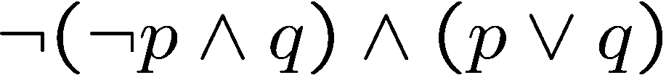
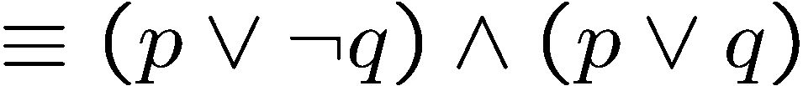
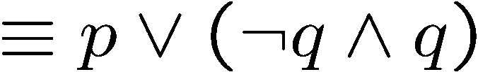


Simplifying Statement
DeMorgan
Distributive
See textbook for more identities.

Slide 18


Tautology, Contradiction
A tautology is a statement that is always true.
A contradiction is a statement that is always false.
(negation of a tautology)
In general it is “difficult” to tell whether a statement is a contradiction.
It is one of the most important problems in CS – the satisfiability problem.

Slide 19

Conditional Statement
If p then q
p is called the hypothesis; q is called the conclusion
The department says:
“If your GPA is 4.0, then you don’t need to pay tuition fee.”
When is the above sentence false?
It is false when your GPA is 4.0 but you still have to pay tuition fee.
But it is not false if your GPA is below 4.0.
Another example: “If there is a bandh today, then there is no class.”
When is the above sentence false?

Slide 20

Logic Operator
If your GPA is 4.0, then you don’t need to pay tuition fee.”
P
Q
P Q
T
T
T
T
F
F
F
T
T
F
F
T
Convention: if we don’t say anything wrong, then it is not false, and thus true.

Slide 21
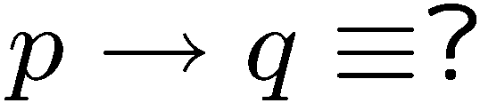
Logical Equivalence
If you see a question in the above form,
there are usually 3 ways to deal with it.
Truth table
Use logical rules
Intuition

Slide 22


If-Then as Or
P
Q
P Q
Idea 2: Look at the false rows,
negate and take the “and”.
T
T
T
T
F
F
F
T
T
F
F
T
If you don’t give me all your money, then I will kill you.
Either you give me all your money or I will kill you (or both).
If you talk to her, then you can never talk to me.
Either you don’t talk to her or you can never talk to me (or both).

Slide 23
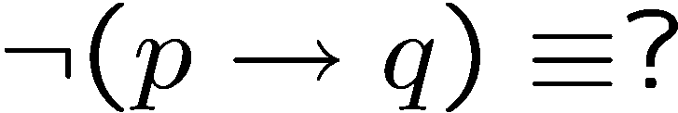




Negation of If-Then
If your GPA is 4.0, then you don’t need to pay tuition fee.
Your term GPA is 4.0 and you still need to pay tuition fee.
If my computer is not working, then I cannot finish my homework.
My computer is not working but I can finish my homework.
previous slide
DeMorgan

Slide 24
Contrapositive
The contrapositive of “if p then q” is “if ~q then ~p”.
Statement: If you are a CS year 1 student,
then you are taking CTS002.
Contrapositive: If you are not taking CTS002,
then you are not a CS year 1 student.
Statement: If x² is an even number,
then x is an even number.
Contrapositive: If x is an odd number,
then x² is an odd number.
Fact: A conditional statement is logically equivalent to its contrapositive.

Slide 25










Proofs
Statement: If P, then Q
Contrapositive: If Q, then P.
If (there is bandha today) p , then (there will be no classes) q.
There will be classes today (~q), then there is no bandh today (~p).
T | T | T
T | F | F
F | T | T
F | F | T
F | F | T
T | F | F
F | T | T
T | T | T

Slide 26
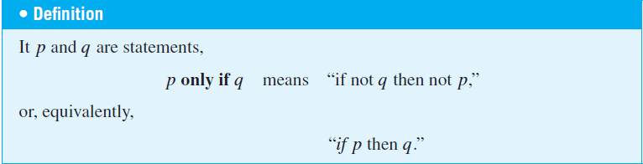
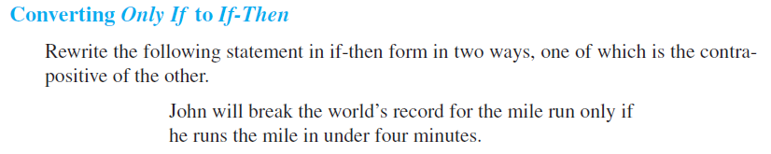
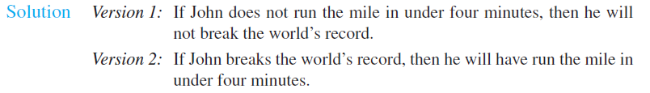
Only-If

Slide 27
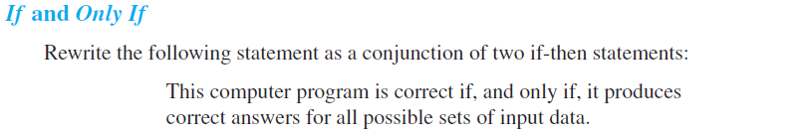

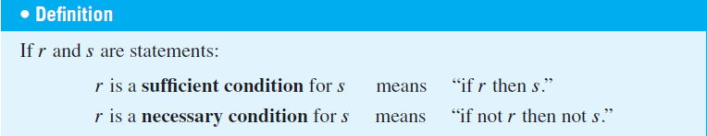
If, Only-If
necessary condition and sufficient condition
P if and only if (iff) Q means P and Q are logically equivalent.
That is, P implies Q and Q implies P.

Slide 28




Necessary AND Sufficient Condition
P
Q
P Q
T
T
T
T
F
F
F
T
F
F
F
T
Note: P Q is equivalent to (P Q) (Q P)
Note: P Q is equivalent to (P Q) ( P Q)

Slide 29

Argument
An argument is a sequence of statements.
All statements but the final one are called assumptions or hypothesis.
The final statement is called the conclusion.
An argument is valid if:
whenever all the assumptions are true, then the conclusion is true.
If today is Wednesday, then yesterday was Tuesday.
Today is Wednesday.
Yesterday was Tuesday.

Slide 30
Modus Ponens
If p then q.
p
q
If bandh, then class cancelled.
Bandh.
Class cancelled.
assumptions
conclusion
p | q | p→q | p | q
T | T | T | T | T
T | F | F | T | F
F | T | T | F | T
F | F | T | F | F
Modus ponens is Latin for “method of affirming”.

Slide 31
Modus Tollens
If p then q.
~q
~p
If Bandh, then class cancelled.
Class not cancelled.
No Bandh.
assumptions
conclusion
p | q | p→q | ~q | ~p
T | T | T | F | F
T | F | F | T | F
F | T | T | F | T
F | F | T | T | T
Modus tollens is Latin for “method of denying”.

Slide 32
Exercise
Show that the premises :
1. “It is not sunny this afternoon and it is colder than yesterday,”
2. “We will go swimming only if it is sunny,”
3. “If we do not go swimming, then we will take a canoe trip,” and
4. “If we take a canoe trip, then we will be home by sunset”
lead to the conclusion:
“We will be home by sunset.”

Slide 33
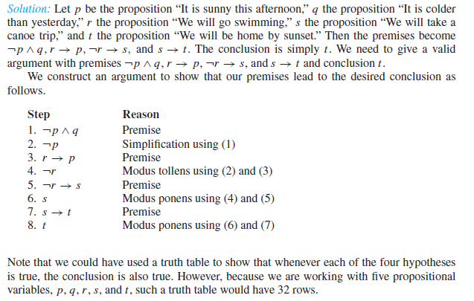
Premises :
1. “It is not sunny this afternoon and it is colder than yesterday,”
2. “We will go swimming only if it is sunny,”
3. “If we do not go swimming, then we will take a canoe trip,” and
4. “If we take a canoe trip, then we will be home by sunset”
Conclusion: “We will be home by sunset.”
Exercise

Slide 34
Equivalence
A student is trying to prove that propositions P, Q, and R are all true.
She proceeds as follows.
First, she proves three facts:
P implies Q
Q implies R
R implies P.
Then she concludes,
``Thus P, Q, and R are all true.''
Proposed argument:
assumption
Is it valid?
conclusion

Slide 35




Valid Argument?
Is it valid?
assumptions
conclusion
P | Q | R
T | T | T
T | T | F
T | F | T
T | F | F
F | T | T
F | T | F
F | F | T
F | F | F
T | T | T
T | F | T
F | T | T
F | T | T
T | T | F
T | F | T
T | T | F
T | T | T
 | OK?
T | yes
F | yes
F | yes
F | yes
F | yes
F | yes
F | yes
F | no
To prove an argument is not valid, we just need to find a counterexample.

Slide 36
Valid Arguments? (Converse Error)
assumptions
conclusion
p | q | p→q | q | p
T | T | T | T | T
T | F | F | F | T
F | T | T | T | F
F | F | T | F | F
If p then q.
q
p
Assumptions are true, but not the conclusion.
If you are a fish, then you drink water.
You drink water.
You are a fish.

Slide 37
Valid Arguments? (Inverse Error)
assumptions
conclusion
p | q | p→q | ~p | ~q
T | T | T | F | F
T | F | F | F | T
F | T | T | T | F
F | F | T | T | T
If p then q.
~p
~q
If you are a fish, then you drink water.
You are not a fish.
You do not drink water.

Slide 38
Exercise
Converse Error
Inverse Error
If p then q.
q
p
If p then q.
~p
~q
If you are a fish, then you drink water.
You drink water.
You are a fish.
If you are a fish, then you drink water.
You are not a fish.
You do not drink water.

Slide 39


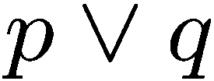
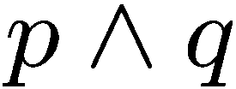



Exercises

Slide 40




More Exercises
Valid argument True conclusion
True conclusion Valid argument

Slide 41

Contradiction
If you can show that the assumption that the statement
p is false leads logically to a contradiction,
then you can conclude that p is true.
You are wearing a jacket.
If it was warm, then you would not have worn a jacket.
It is not warm.

Slide 42
Knights and Knaves
Knights always tell the truth.
Knaves always lie.
A says: B is a knight.
B says: A and I are of opposite type.
Suppose A is a knight.
Then B is a knight (because what A says is true).
Then A is a knave (because what B says is true)
A contradiction.
So A must be a knave.
So B must be a knave (because what A says is false).

Slide 43
Quick Summary
Conditional Statements
The meaning of IF and its logical forms
Contrapositive
If, only if, if and only if
Arguments
definition of a valid argument
method of affirming, denying, contradiction
Key points:
Make sure you understand conditional statements and contrapositive.
Make sure you can check whether an argument is valid.

Slide 44
Key points to know
Write a logical formula from a truth table.
Check logical equivalence of two logical formulas.
DeMorgan’s rule and other simple logical rules (e.g. distributive).
Use simple logical rules to simplify a logical formula.
Make sure you understand conditional statements and contrapositive.
Make sure you can check whether an argument is valid.

Slide 45
Which is true?
Which is false?
“The sentence below is false.”
“The sentence above is true.”

